Slide 1
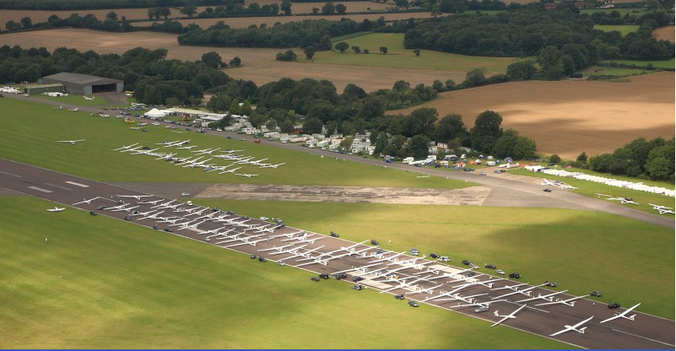
Emergency Glider Evacuation
– an IGC Safety Promotion

Slide 2
If you can get out of the glider in just
4 seconds
Your minimum height for survival is
600m
OSTIV research

Slide 3
BEFORE you take off, answer 2 key questions:
What situation would make you bale out?
What is the Emergency Canopy Jettison procedure for your glider?
The following slides are suggestions for your consideration, not necessarily a direct instruction

Slide 6
Should I bale out?
Do you have enough height for a successful bale out?
If it’s marginal and even if the glider seems to be flying normally, baling out while there is enough height for successful parachute deployment is the safest option.

Slide 7
Baling Out:
Open the brakes
The wing might come off, but probably not, and if you are headed down it slows acceleration and gives more time between now and hitting the ground or break up due to Vne / flutter.
Get out of the glider... See over

Slide 8
Getting out of a glider... in a spiral dive
In a spiral dive - increasing positive “G”
release the canopy (it may or may not leave the aircraft)
release the straps and shove the stick hard forward - you will probably be thrown out of the glider. Otherwise roll over the side of the cockpit.

Slide 9
Getting out of a glider... in negative pitch
If negative pitch, this means the tailplane is damaged or gone, so:
release the canopy
release the straps and you will leave the glider very quickly indeed.
Again, it doesn't really matter if the canopy is still there, you will take it with you.

Slide 12
Once you get out, pull the ripcord immediately.
Practice this:
LOOK (at the D ring)
GRASP (thumb of left hand through the ring, the other hand on top to lock your hands onto it - so you don't fumble)
PULL (a long pull in line with the bowden cable)
And then ARCH (hands up over head, chest forwards to get a clean shape to minimise chance of a malfunction).

Slide 13
If you are ABOVE min bale-out ht:
If you have control of the glider you can start to assess the damage - which parts are damaged and how badly.
Always keep the minimum survivable bale out height in mind. Regardless of your where you are with your damage evaluation, if you reach the height limit, bale out.

Slide 14
Is the glider damaged at the back end?
even if it is still flying, you should get out anyway

Slide 15
If the back end is not damaged:
Close the brakes if open and check that you have full elevator, aileron and rudder control
Try to assess the visible damage.
If both of the above are OK, flying down is an option.

Slide 16
If you are going to fly down:
Make an emergency radio call
Where will you land?
Are you in gliding range of an airfield or suitable? Are there roads and signs of people?
Fly the glider so as to minimise the loads on the airframe.

